Slide 1
For all your property needs
PPRA CERT NO: 2023116166

Slide 2
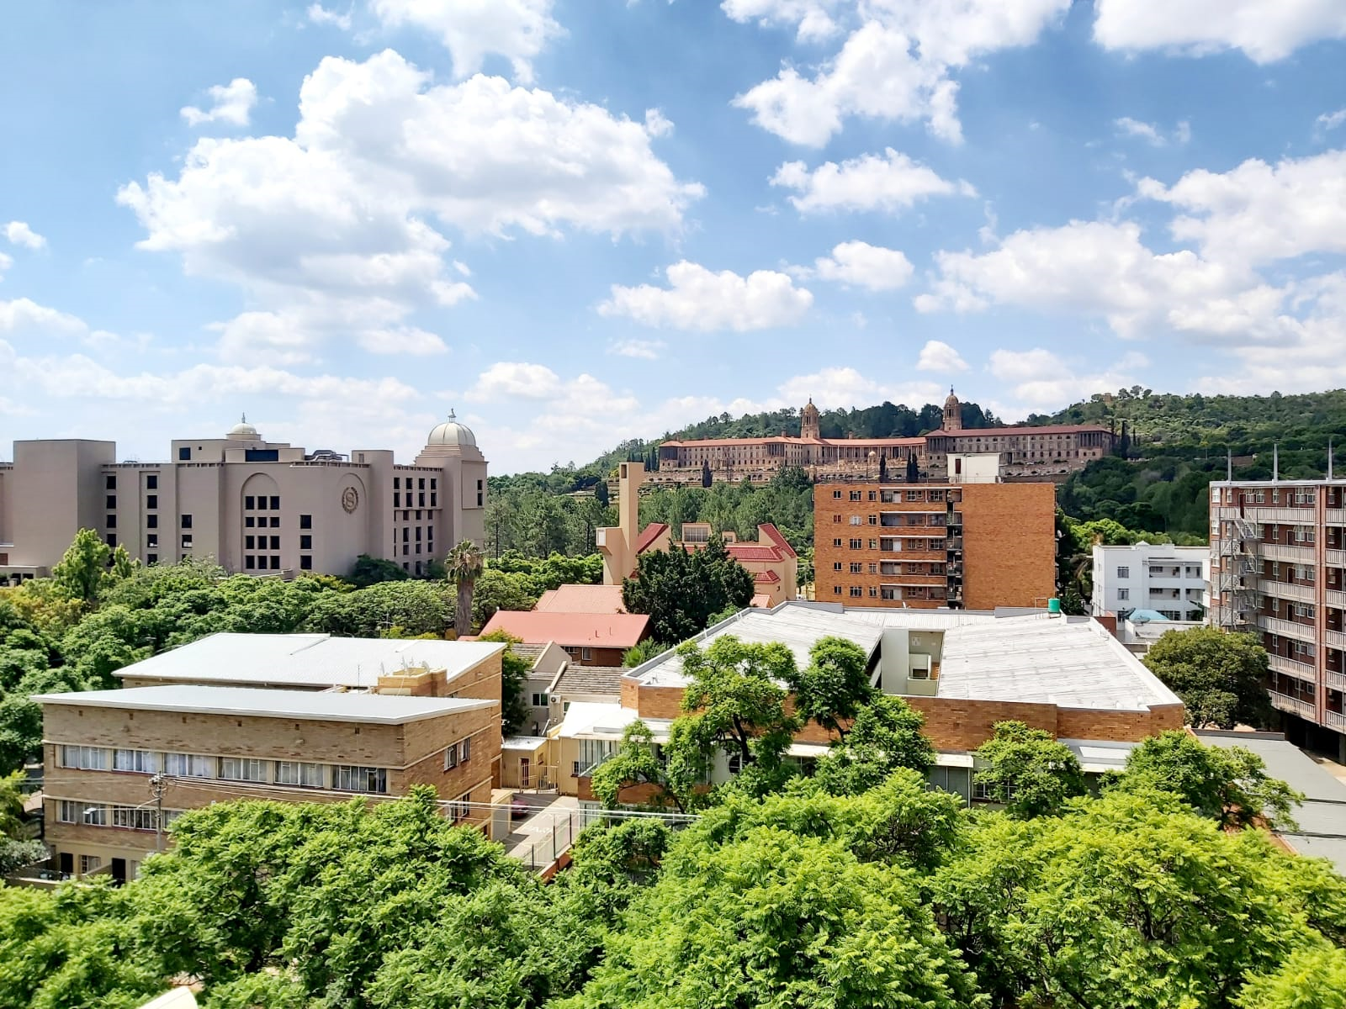
: 012 023 0894
: info@summithomessa.com
: @summithhomes_sa
:https://www.facebook.com/summithomes.sa
: www.summithomessa.com
: 670 12th Avenue, Gezina. Pretoria 0031

Slide 3
ABOUT SUMMIT HOMES
Summit Homes was founded by a team of experienced Property Practitioners that has been in the Real Estate industry for about a decade.
Summit Homes offers Property Sales, Management, Rental (retail & Commercial) and Property Maintenance.
Summit Homes is a 100% Black-owned company.
Areas of operation include; Pretoria CBD, Equestria, Mooikloof, Akasia, Zambezi, Amandasig, Annlin, The Orchards, Magaliesburg, Nelmafias, Hartebeestpoort some areas in Centurion & Silverton environs.
Also see more listings on Property24: https://www.property24.com/estate-agents/summit-homes/32407

Slide 4
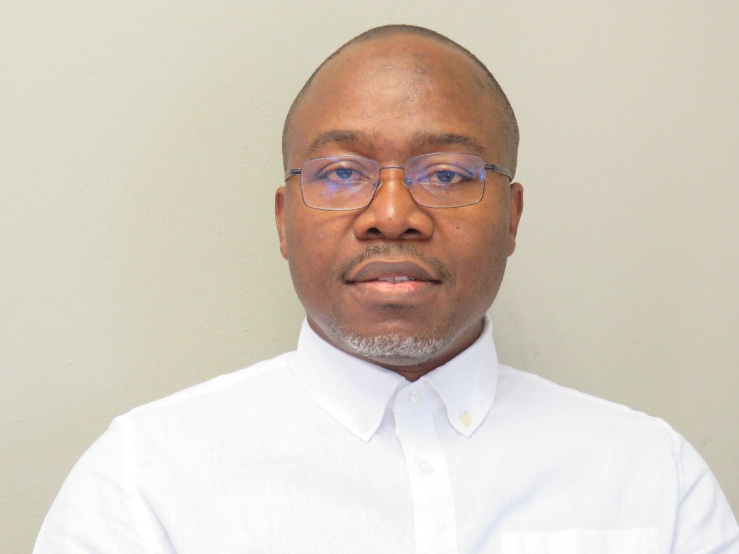
Directors
Benny Alaga
Cell: 065 934 9978
Kunle Alaga
Cell: 078 133 6945

Slide 5
Vision & Mission
Bearing in mind customer service excellence, our aim is to raise the standard in property industry. Working with a dedicated team with their individual specialized skills and service expertise, our range of clients are rest assured that Summit Homes has their best interests at heart. Our goal is to exceed customer expectations.

Slide 6
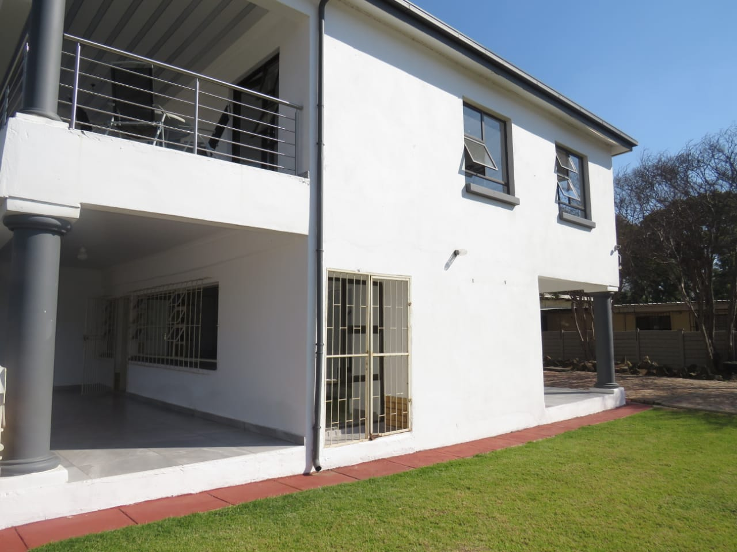
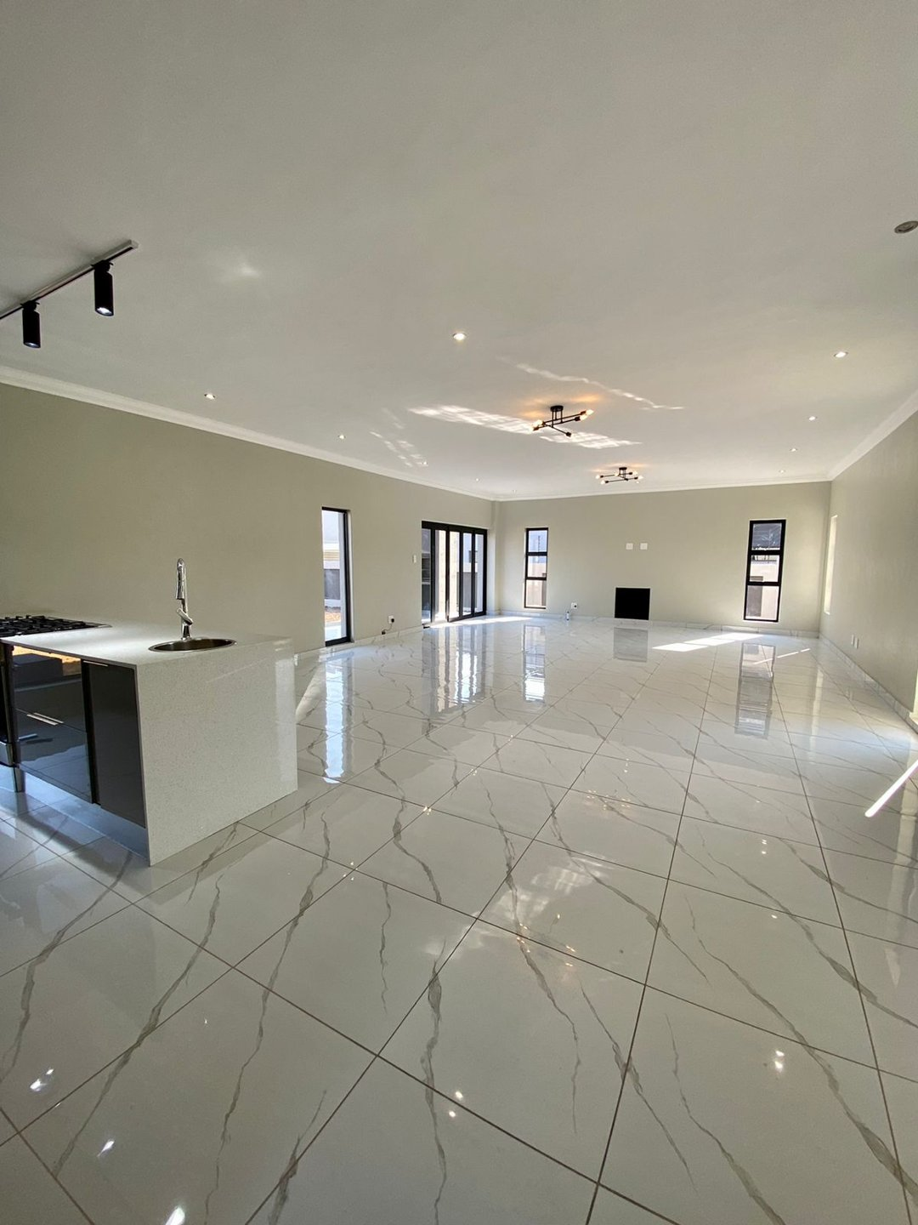
A few of Summit Homes’ listings
House for sale in Savannah, Country Home | R2 900 000-00
House for sale in Kilner Park | R2 500 000-00
4 Bedroom house for sale in Zambezi Manor lifestyle Estate
For more of our listings, go to Property24: https://www.property24.com/estate-agents/summit-homes/32407

Slide 7
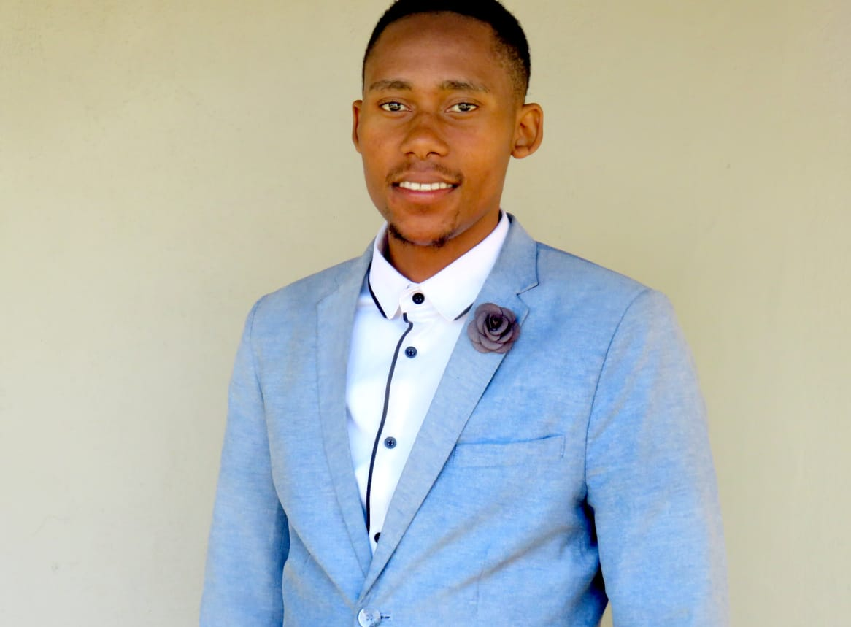
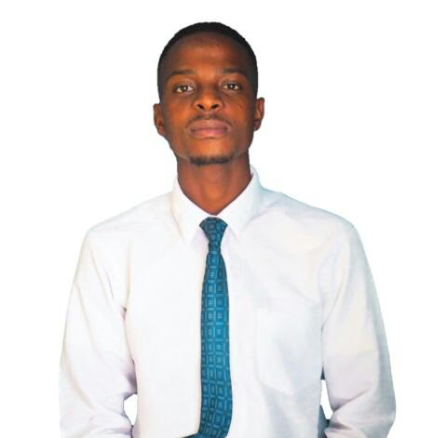
Meet the rest of the team
Precious
radi
Seun
Mohau
Mike
Raphael
Moses

Slide 8
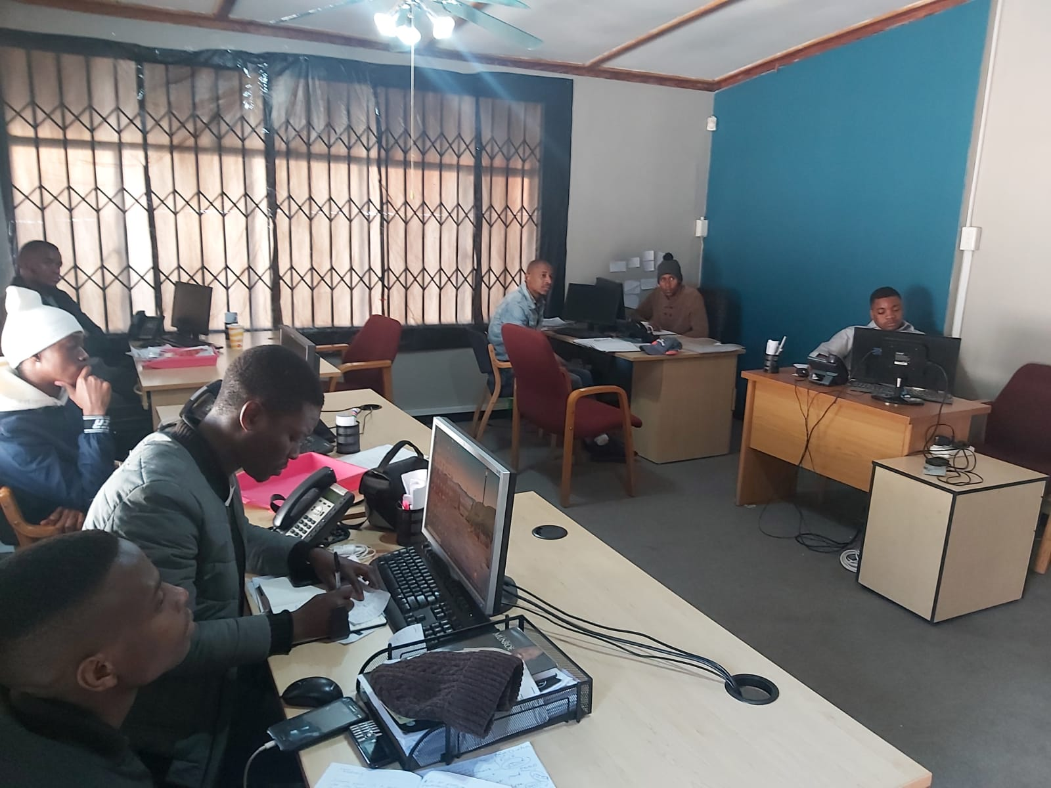
What we offer
TRAINING
PROPERTY
INVESTMENTS
FINANCE
Offering courses on topics related to real estate, investments and finance all to whomever would like to broaden their horizons. Property Everything from property sales , property valuations, management - our skilled team of property specialists will be right there to walk you through the process.
Everything from property sales , property valuations, management - our skilled team of property specialists will be right there to walk you through the process.
We offer a lifetime property investing course where our skilled team will be able to assist clients in choosing the most lucrative investment property to add to their portfolio.
We can assist a client in receiving something as simple as a Home Loan at some of the best rates available.

Slide 9
Affiliates
Dimension Home loans
[PPRA] Property Practitioners Regulatory Authority
[CSOS] Community Schemes Ombud Service
MD Mitchell Attorneys

